Slide 1


PROJECT REVIEW
Control and Management of Railway System
Connected to Microgrid Stations​​
Under The Esteemed Guidance Of​
Dr. K. Chithambaraiah Setty _{Ph.D.}​
HOD(EEE) & Vice-Principal​
BY​
BUGUDI MOHAN KUMAR -> 20G31A0207​​ MALIREDDY LAKSHMAN -> 20G31A0215​​ SEELAM RAJASEKHAR -> 20G31A0221​​
BOYA RAMAKRISHNA -> 20G31A0205 M FAREED AKRAM -> 21G35A0215​

Slide 2

CONTENTS
ABSTRACT
INTRODUCTION
LITERATURE SURVEY
EXISTING SYSTEM & DISADVANTAGE
PROPOSED SYSTEM
COMPONENTS REQUIRED & APPLICATIONS
BLOCK DIAGRAM
WORKING PRINCIPLE
ADVANTAGES
MATLAB SIMULATION
CONCLUSION
FUTURE SCOPE

Slide 3
ABSTRACT
The proposed design of railway station use PV and wind sources, and batteries for energy storage system (ESS).
For the train, Super Capacitors(SCs) are implemented to the ESS where they are alimented breaking phases and from stations by a pantograph installed in an air power line in each stop.
SCs are distinguished by high characteristics power and a wide number of charge/discharge cycles.
They provide low particular energy and a fast charging time.
An energy management approach is suggested to control the DC bus voltage and the buck-boost converter for current.
Simulations for the train and station show the suitability of the suggested powertrain and control strategy.

Slide 4
INTRODUCTION
In the last few decades, generally there is a major growth in energy utilization and pollutions.
The growing number of citizen traveling between cities has implied the continuous development of mass transit systems as buses, taxies, and trains.
However, the use of railway transportation systems other conventional means of transport is widely recognized due to the Carrying capacity of a large number of people.
The development of rail transportation allows people to travel quickly. Thereby, growing environmental issues like climate change and CO2 emissions.
For these reason the electric railway traffic has become a principal development and management of current public transportation networks.

Slide 5
LITERATURE SURVEY
The railway system has been studied successfully in many articles by researches such as:
Jiang presents a fast inspection method for high-speed railway infrastructure monitoring.
Feng gives the electric railway smart microgrid system with integration of multiple energy systems and power-quality improvement.
Khayyam gives railway system energy management optimization demonstrated at offline and online case studies.
Zhang presents the method using a prediction approach, He shown the energy harvesting approach for railway wagon monitoring sensor with high reliability and simple structure.
Sun presents the hybrid method for life prediction of railway and Novak presents the hierarchical model predictive control for coordinated electric railway traction system energy management
Sengor gives the energy management of a smart railway station considering regenerative braking and stochastic behavior of ESS and PV Generation.

Slide 6
EXISTING SYSTEM: Existing method using a prediction approach, and energy harvesting approach for railway wagon monitoring.
DISADVANTAGES:​​
High cost​​
Need more sensor​​
Not proper working​

Slide 7
PROPOSED SYSTEM
COMPONENTS REQUIRED
PACK OF SUPER-CAPACITOR
BUCK-BOOST CONVERTER
BATTERIES
PHOTOVOLTAIC PANELS
WIND ENERGY SYSTEM
AC-DC CONVERTER
DC BUS
ENERGY MANAGEMENT SYSTEM
ENERRY STOTAGE SYSTEM
APPLICATIONS
Railway station control system
Electric vehicle

Slide 8
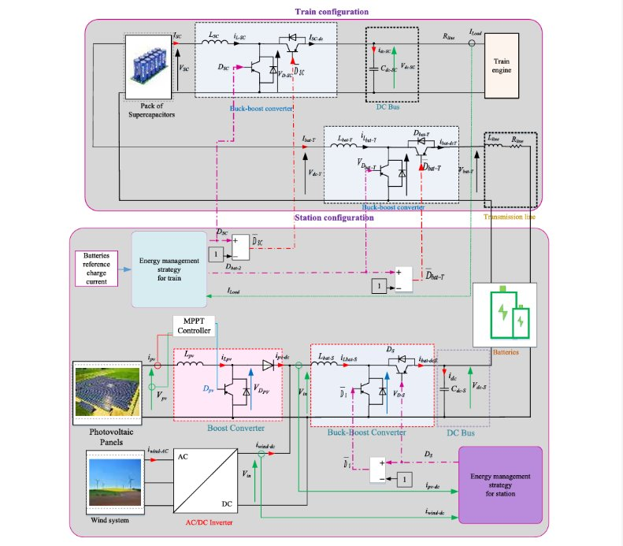
BLOCK DIAGRAM ​
​
​
​Rectifier

Slide 9
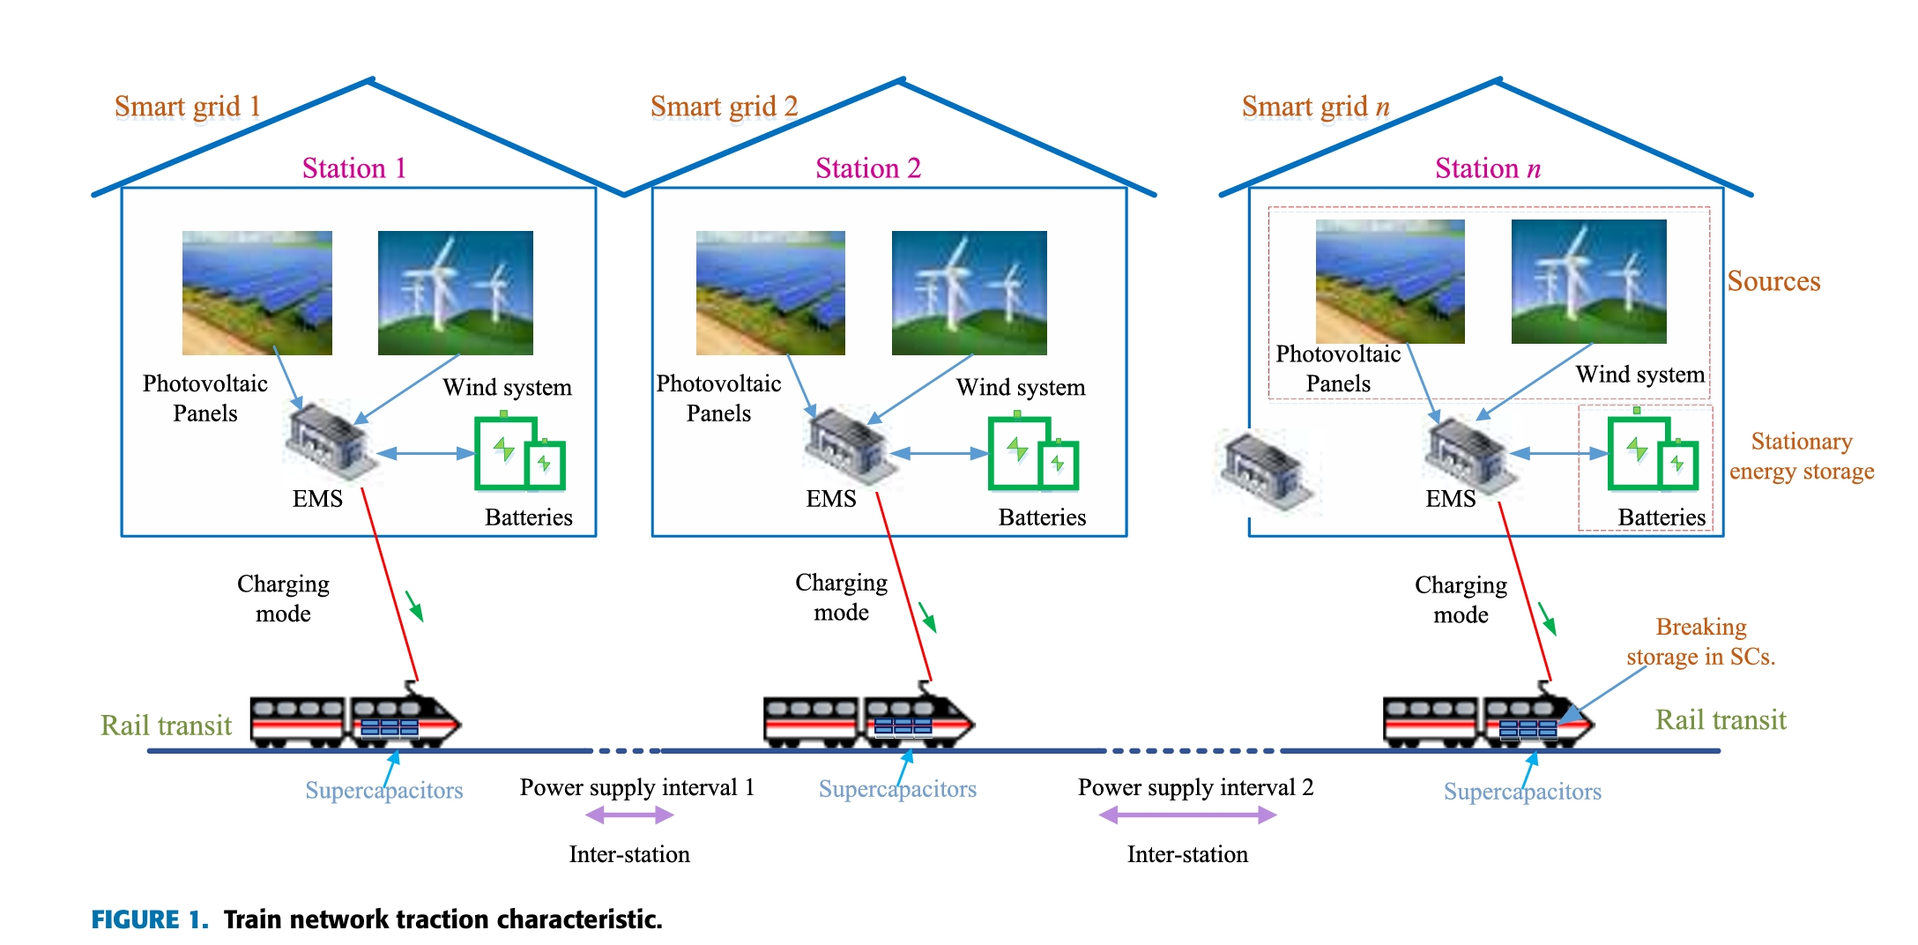
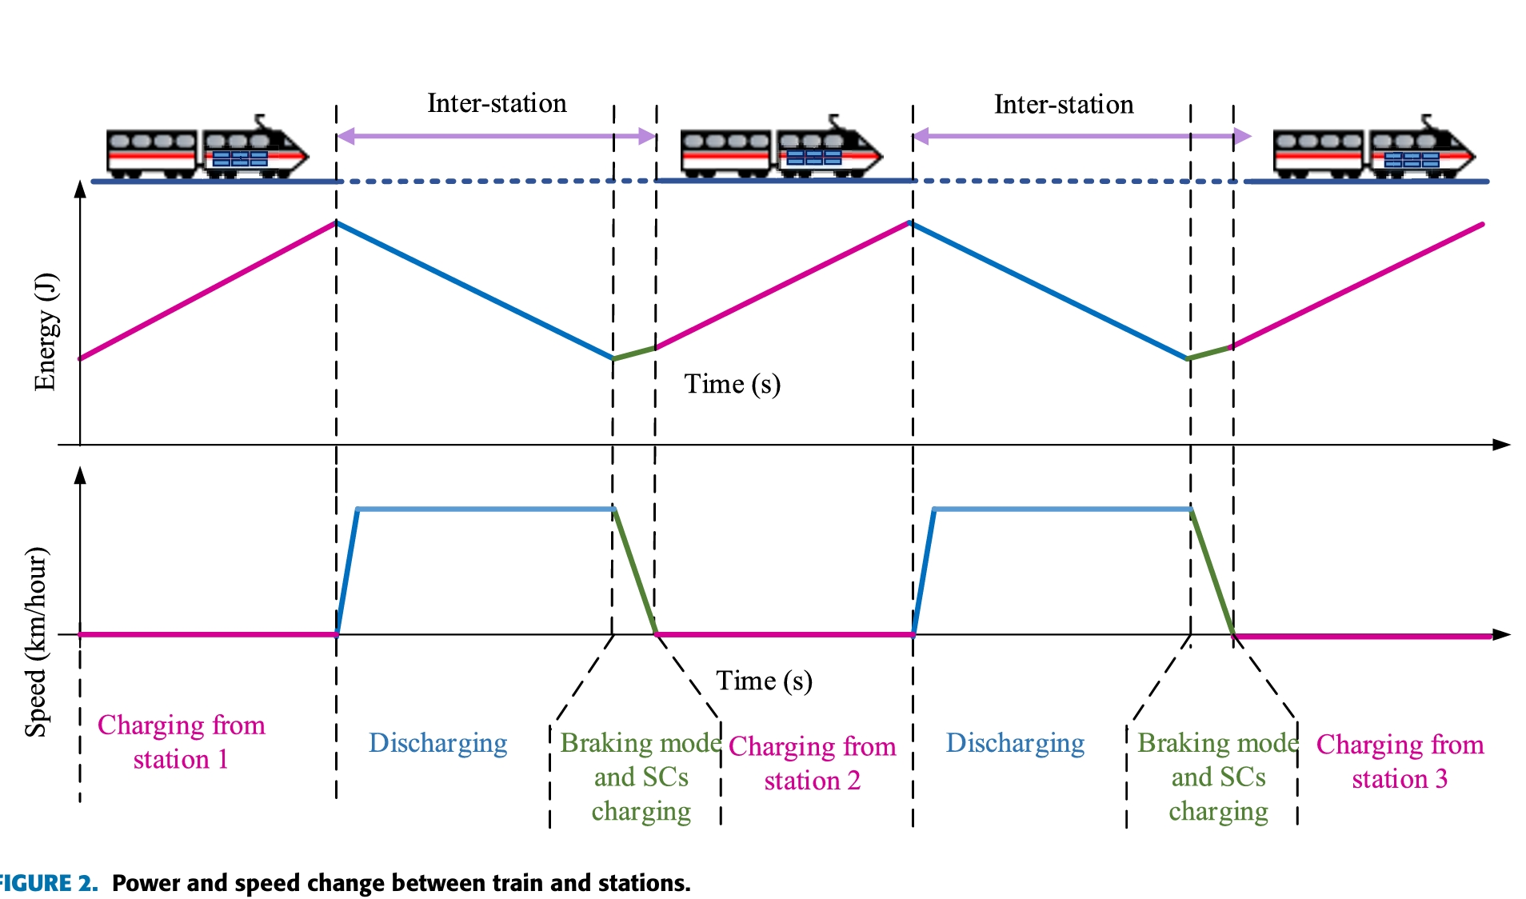
WORKING PRINCIPLE ​

Slide 10
Increasing reliability
Aiding economic growth
efficient, low-cost, clean energy,
enhance local resiliency
Improve the operation and stability of the regional electric grid.
ADVANTAGES

Slide 11
MATLAB
SIMULATION

Slide 12
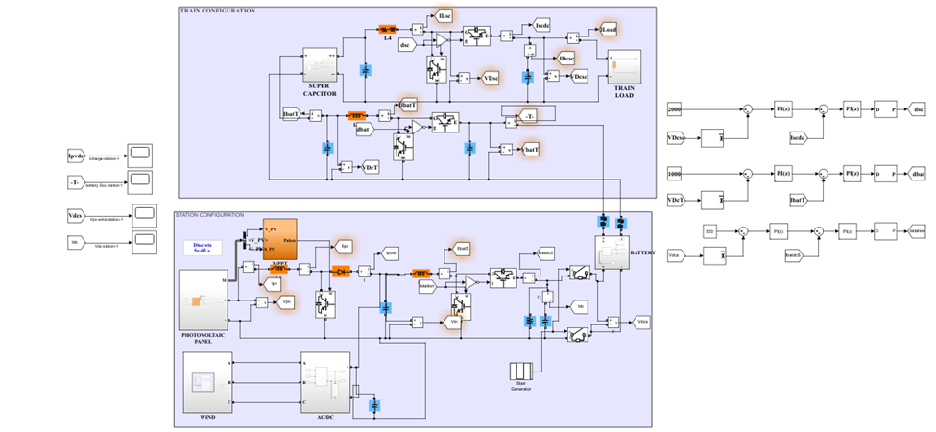
Simulation Test Of Station 1
At Station 1 With Train-1 Configuration

Slide 13
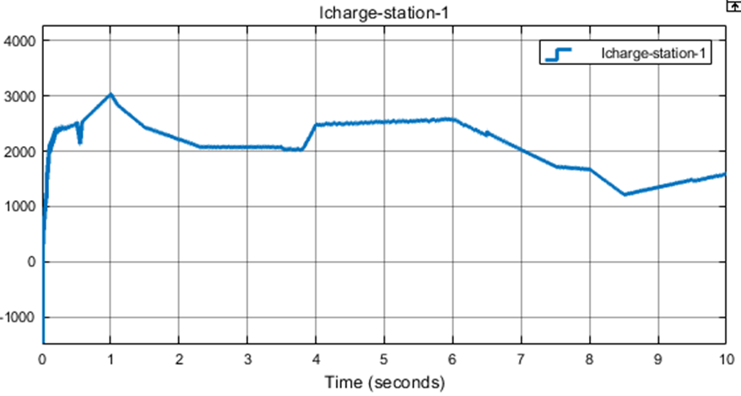
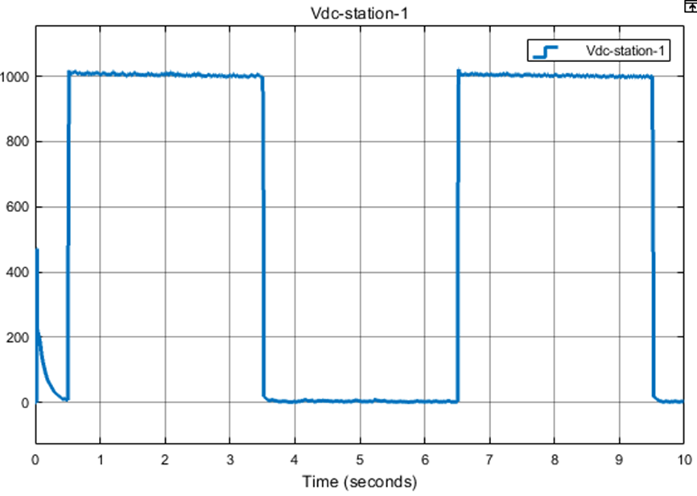
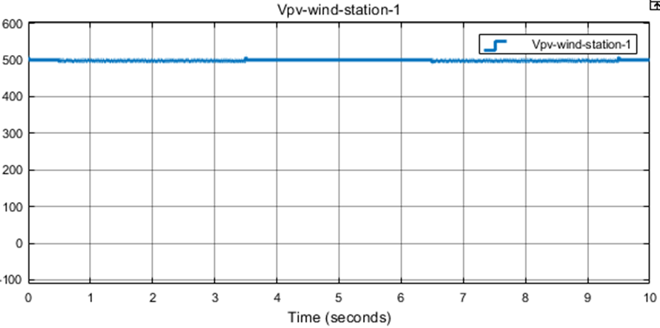
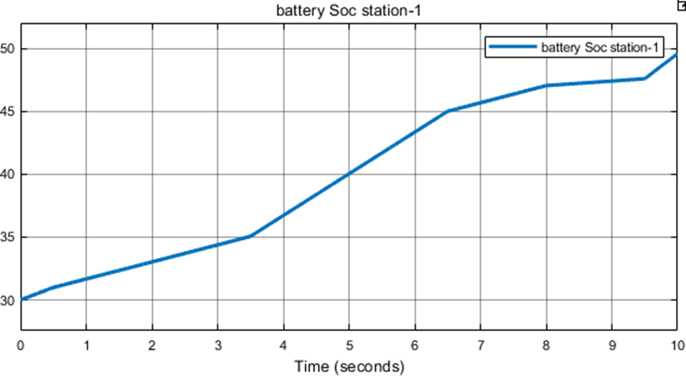
A
A
PV and wind current of station 1
Charge current from station 1
V
Charge %
DC bus voltage of station 1
SoC of batteries of station 1

Slide 14
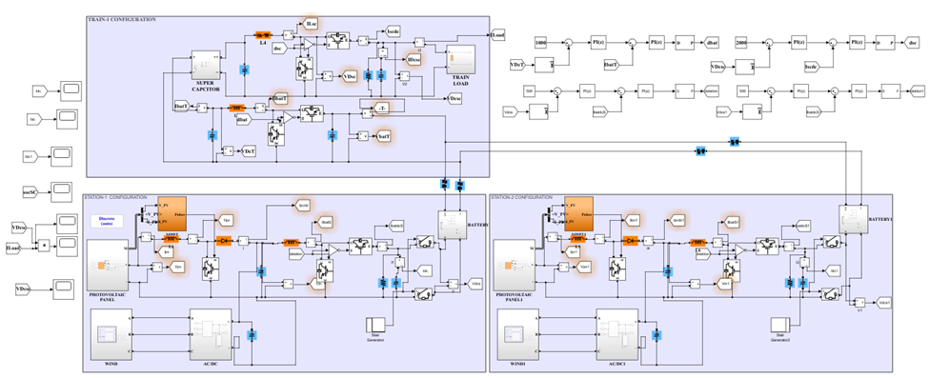
Simulation Test Of Train 1
At Station 1 And Station-2 With Train-1 Configuration

Slide 15
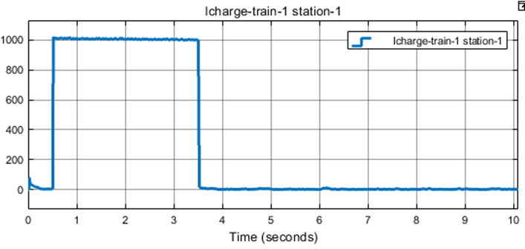
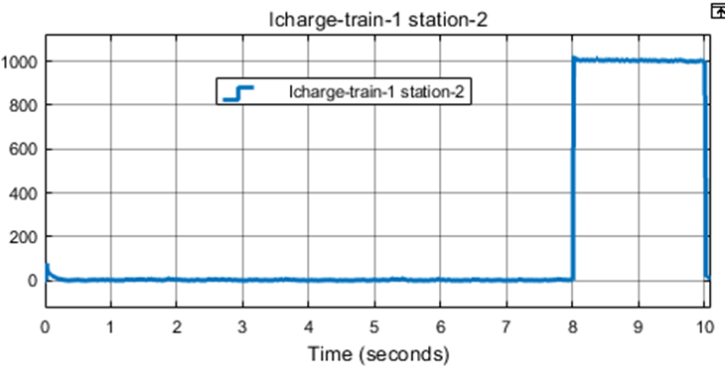
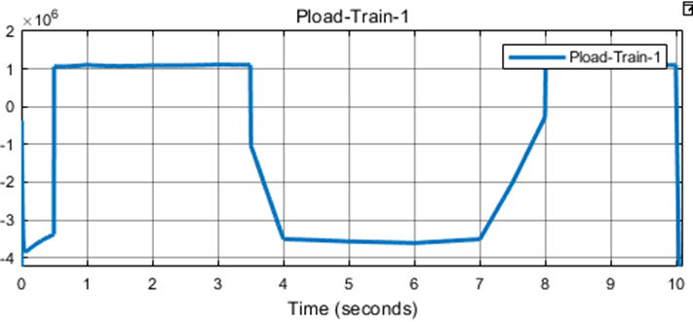
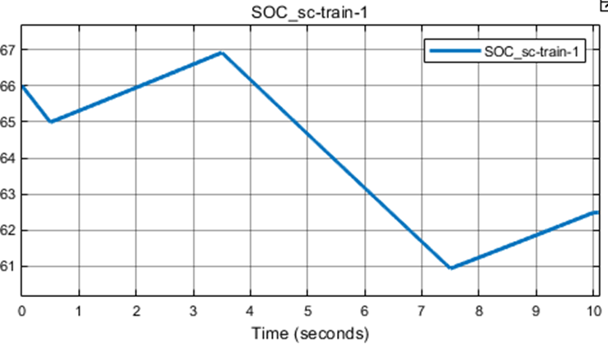
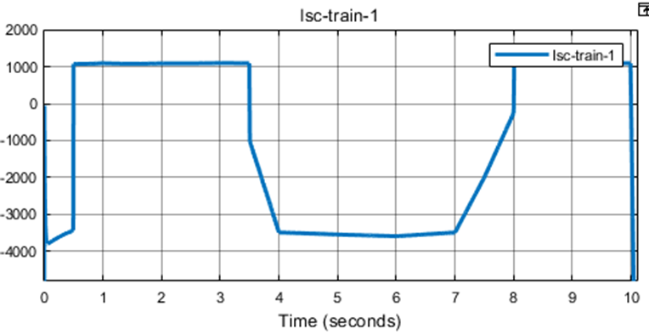
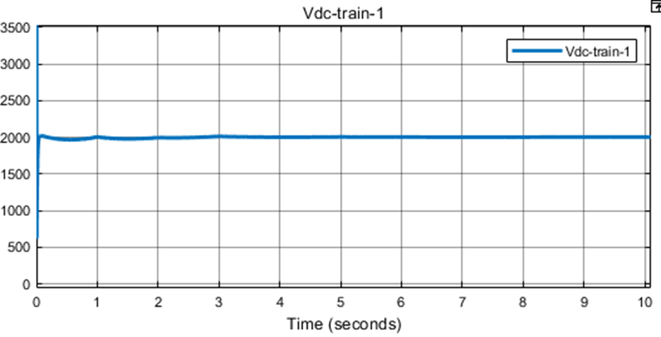
A
A
M Watts
Charge current of train 1 from station 1
Charge current of train 1 from station 2
Load power of train 1
A
Charge %
V
SCs current of train 1
SoC of SCs of train 1
DC bus voltage of train 1

Slide 16
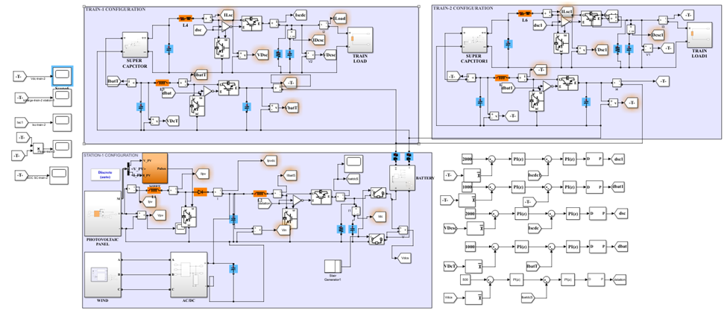
Simulation Test Of Train 2
At Station-1 With Train-1 And Train-2 Configuration

Slide 17
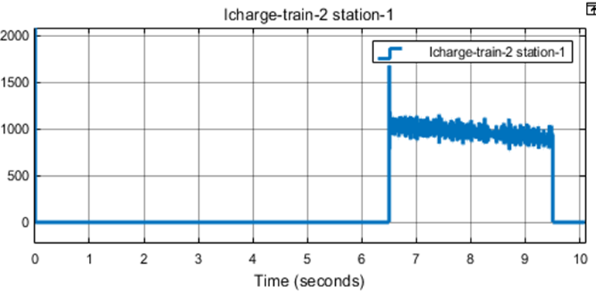
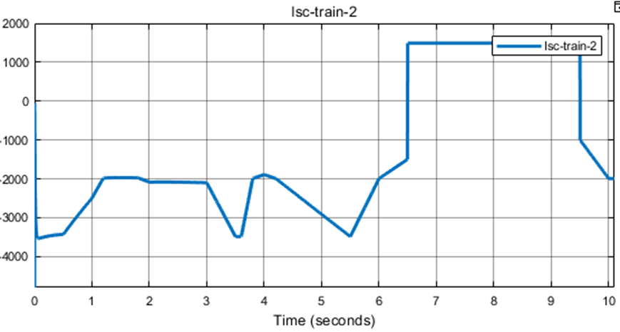
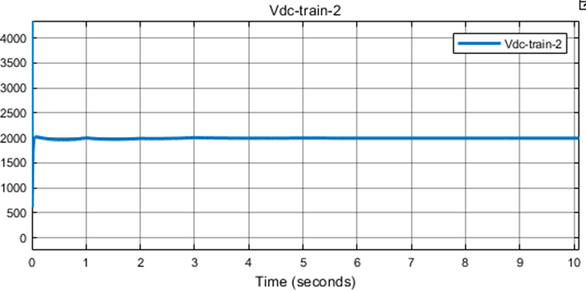
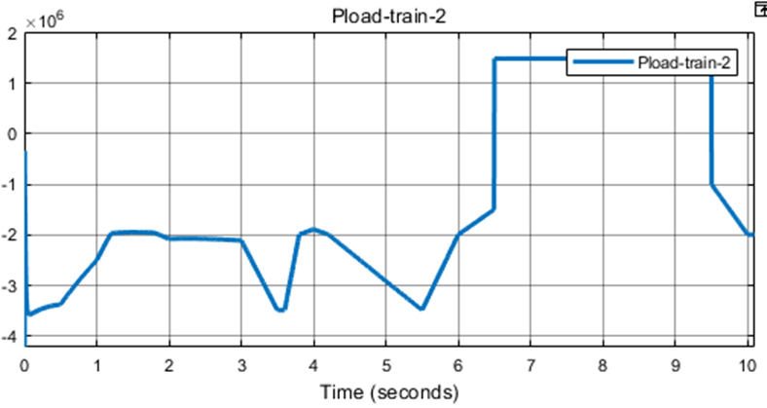
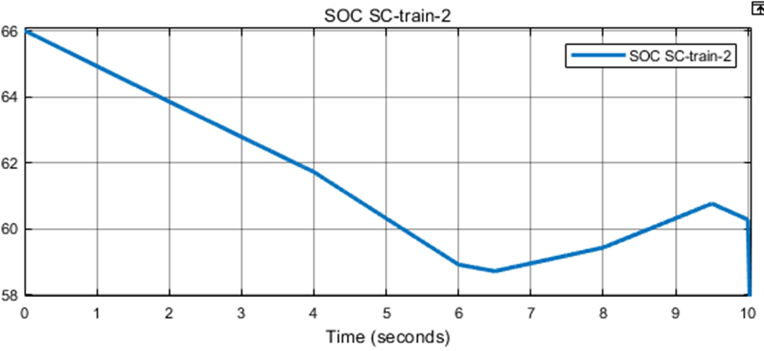
A
A
Charge current of train 1 from station 1
SCs current of train 2.
V
M Watts
Charge %
Load power of train 2
SoC of SCs of train 2
DC bus voltage of train 2

Slide 18
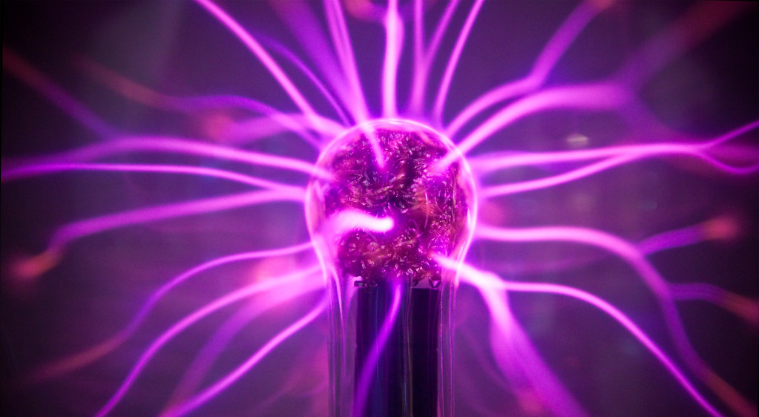
The integration of supercapacitors for fast energy storage, combined with renewable sources at stations, presents a promising solution for sustainable and efficient energy management in train systems, as demonstrated in the proposed project review.
CONCLUSION ​

Slide 19

FUTURE SCOPE
This method can be used for Electric Vehicles and Metro Stations

Slide 20



